Slide 1
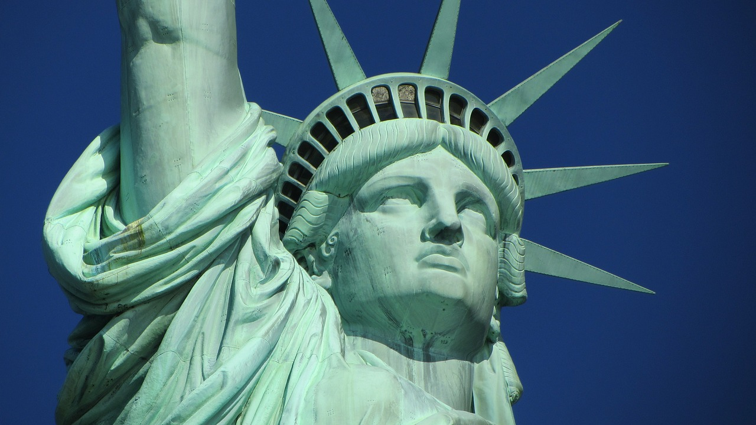

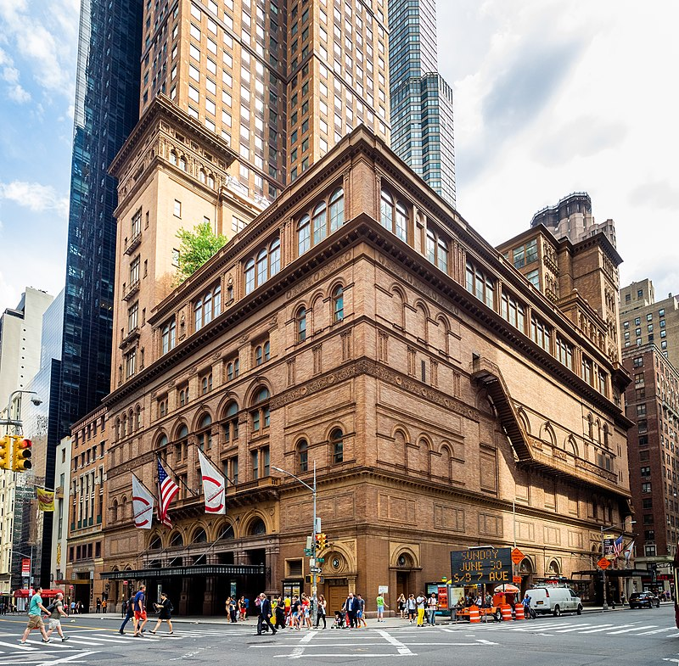
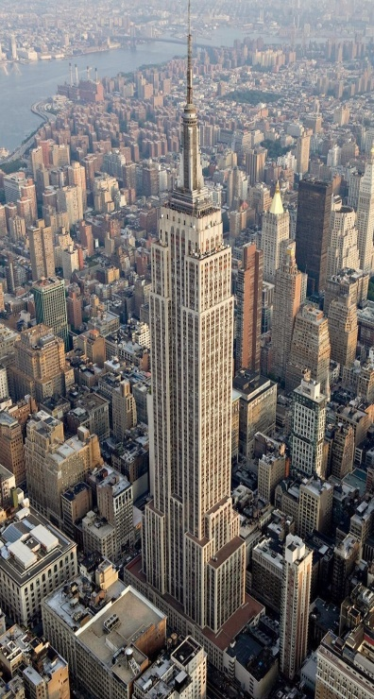
Landmarks & Airbnb Listings in new York city
Alyshia Kiczma
Arshdeep Khurana
Nasir Qadri
Kaylyn Valdez-Scott

Slide 2
Project description
We are a group hired by Airbnb, tasked with creating a dashboard of visualizations showing the locations of Airbnbs listed and the locations of historical landmarks in an interactive map format using latitudes and longitutes

Slide 3
Questions of Interest
What are the major landmarks surrounding boroughs in New York City?
Where can consumers stay when on a trip and what different housing options are available? Ex. Shared rooms, hotel, entire houses.
What are the prices of these locations to stay?

Slide 4
ETL

Slide 5
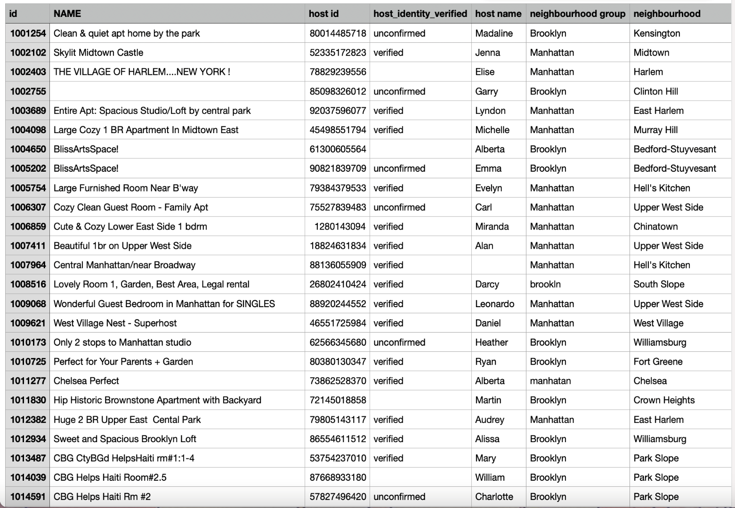
Data set (used in project 1)
https://www.kaggle.com/datasets/arianazmoudeh/airbnbopendata?select=Airbnb_Open_Data.csv

Slide 6
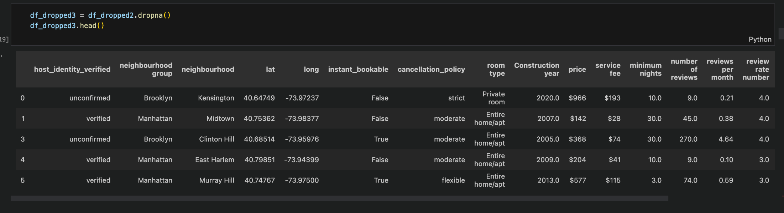

Slide 7
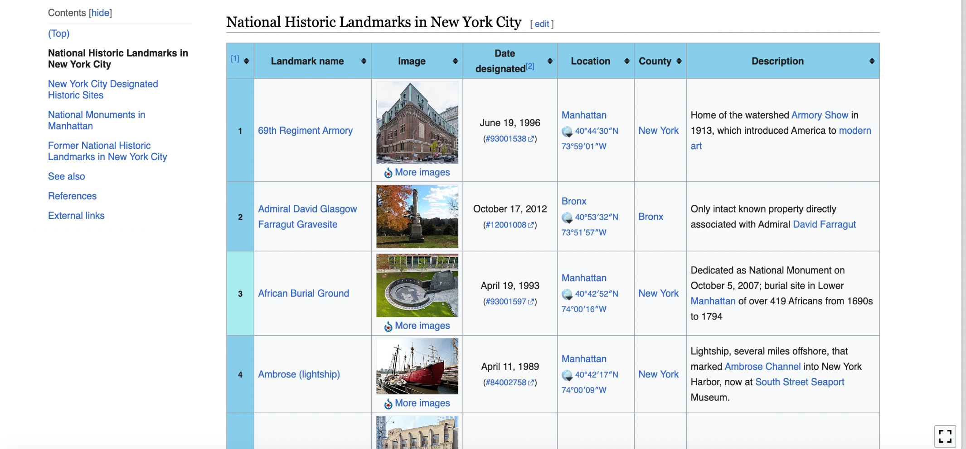
Web Scraping from Wikipedia

Slide 8
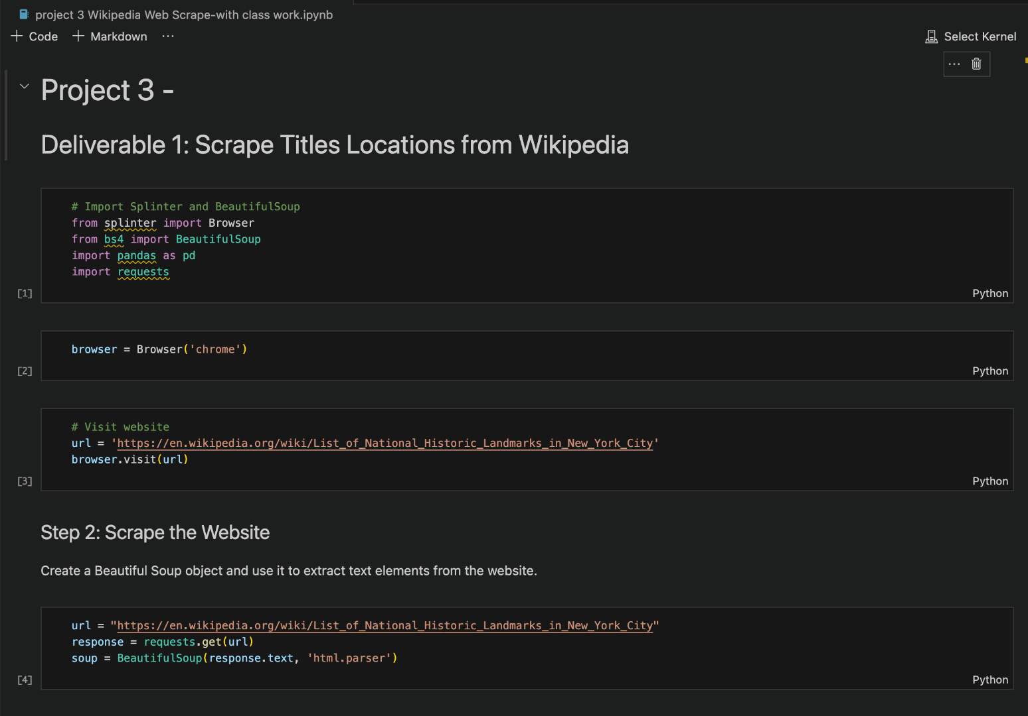
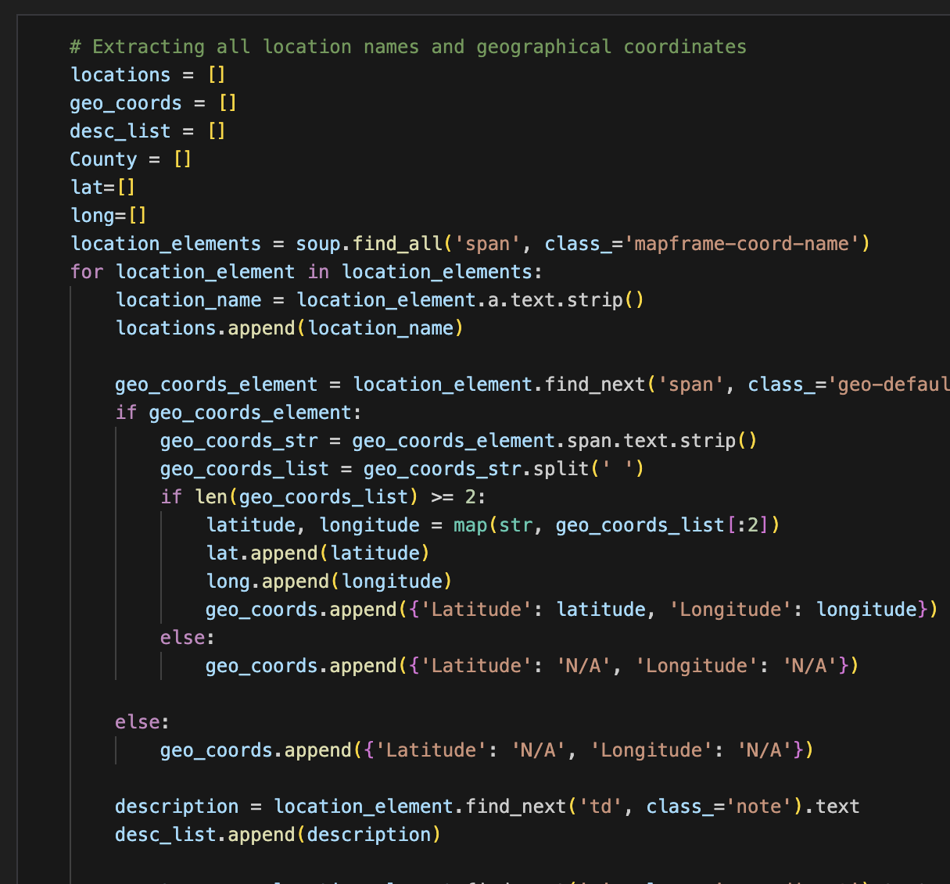

Slide 9
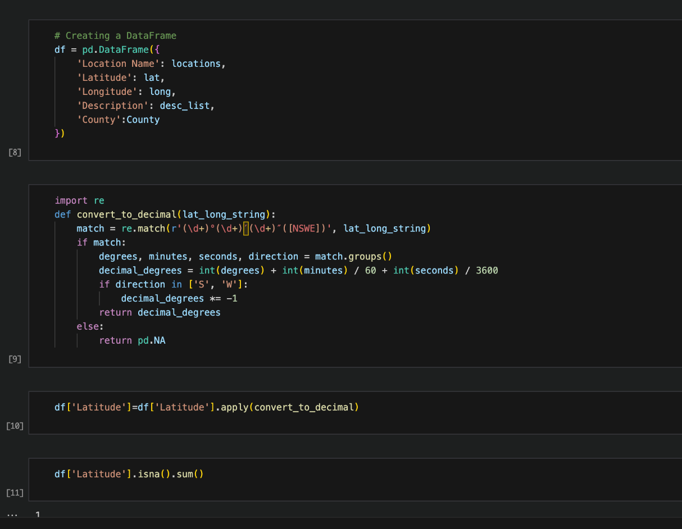
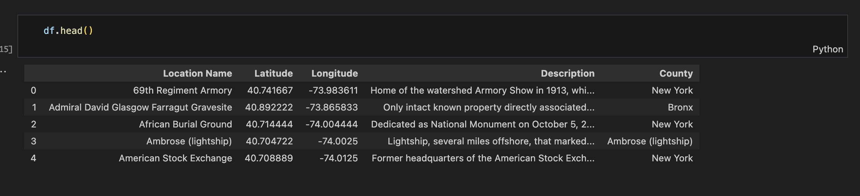
New dataframe

Slide 10
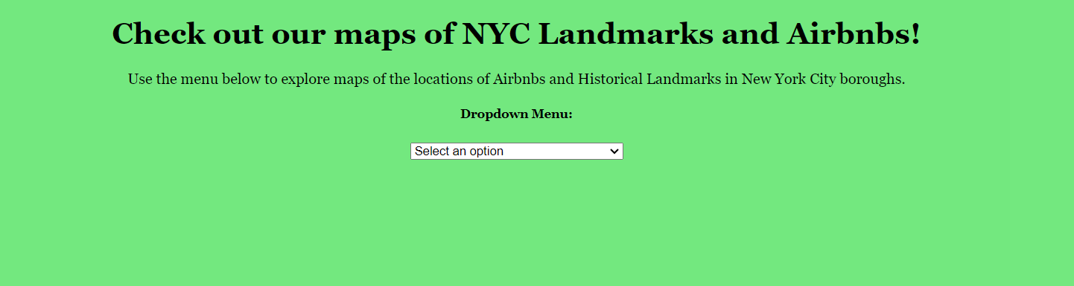
Dashboard

Slide 11
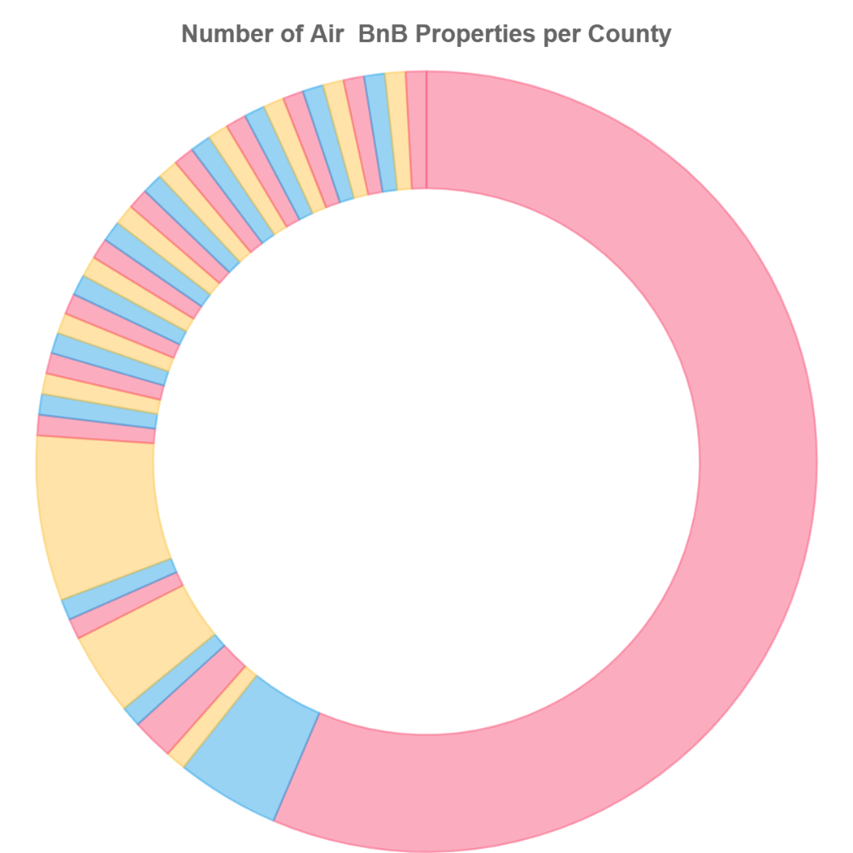
visualizations

Slide 12
map of Airbnb rental locations

Slide 13
map of nyc landmarks

Slide 14
other visualization ??

Slide 15
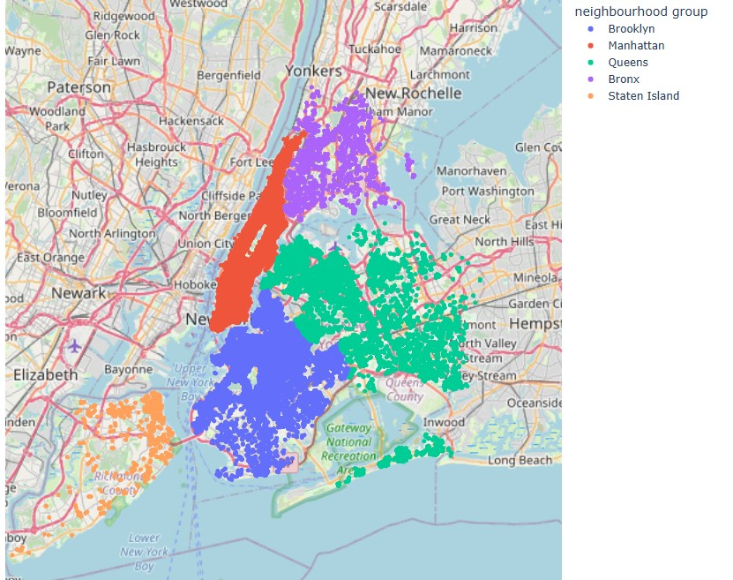
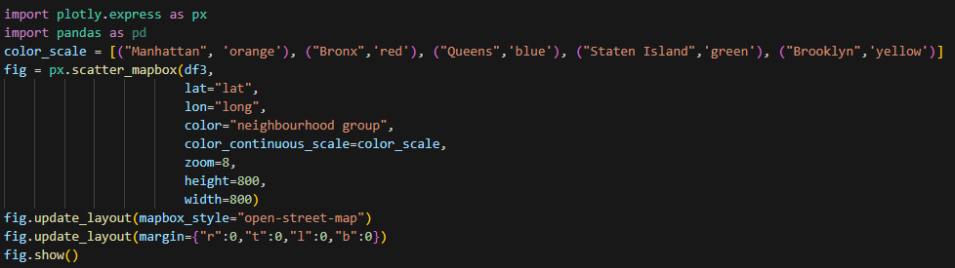
Listing volume by neighbourhood group

Slide 16
Further investigation
do we have any

Slide 17
conclusion

Slide 18
Thank you for listening!

